Slide 1
Chapter 16: Topics in z/OS System Programming

Slide 2
Objectives
In this chapter you will learn to:
  Discuss the responsibilities of a z/OS system programmer
  Explain system libraries, their use, and methods for managing their content
  Configure consoles
  IPL a system

Slide 3
Key terms
HCD
IODF
SYSRES
SMP/E
LNKLST
IPL
WTOR
PARMLIB
PROCLIB
system
symbols
PSA
LPA
nucleus
LOADPARM
SQA

Slide 4
Considerations for a new application
New batch applications to scheduler
New JCL procedures to procedure library
Document operational procedures
Security privileges
Add load libraries to system
Automation
Reload system (if required)

Slide 5
What is systems programming?
A systems programmer installs, customizes and maintains the operating system
To do this they need knowledge of
  Hardware
    Storage
    Processor
  Software
    System libraries and data sets
  Current customization

Slide 6
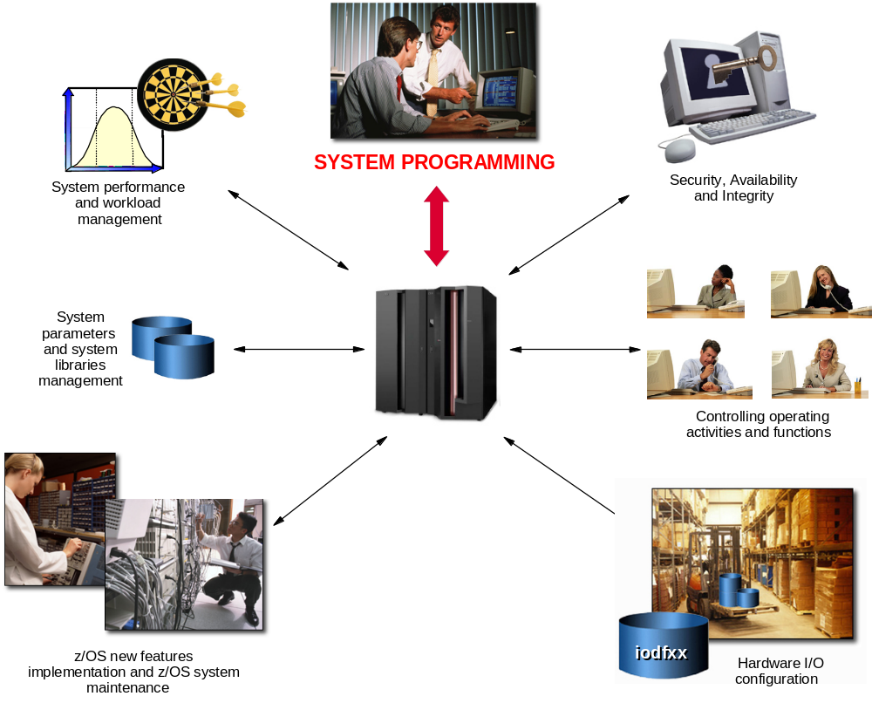
System programming overview

Slide 7
z/OS operational system administration is:
Software installation and maintenance
Customize parameters
System libraries for software
System data sets
z/OS system address spaces and subsystems
Real and virtual storage

Slide 8
z/OS Workload Manager
Workload manager (WLM) is an address space which manages the tasks running on the system
Uses an installation-defined policy to determine relative priority of competing workloads
WLM can also be used to manage hardware resources

Slide 9
System performance
System tuning is constant and iterative
Only a real problem when resources are constrained
WLM is one component
Can only manage what is set up
Initial set up of initiators and other resources plays a great part

Slide 10
Job flow
Job entry subsystem (JES) controls job flow
Receives jobs into system
Initiates the job
Controls initial output processing

Slide 11
I/O device management
Input/output device configuration must be defined to both hardware and software
HCD is used to build an I/O definition file
This definition can be activated to both software and hardware dynamically
Sometimes major changes require an IPL of software or POR of hardware

Slide 12
Security
Protection of data against unauthorized disclosure, transfer, modification or destruction
Systems programmer installs and maintains the security system

Slide 13
Integrity
Designed, implemented and maintained to protect against unauthorized access
Unauthorized software must not be able to access authorized states
Unauthorized software must not be able to bypass system security such as RACF

Slide 14
Availability
System availability is designed to be very high
Many systems require 24 hour 7 day operation

Slide 15
Change control
I/T organizations achieve their goals through disciplined change management processes and policy enforcement
These goals include:
  High service availability
  Increased security
  Audit readiness
  Cost savings

Slide 16
z/OS operation
This is the day to day management of the operating environment both software and hardware
Operator interaction is message and command based
Automated processing of the messages and commands is available and operators now manage by exception

Slide 17
z/OS Production Control
Build batch schedules
Promote programs to production
Investigate batch failures

Slide 18
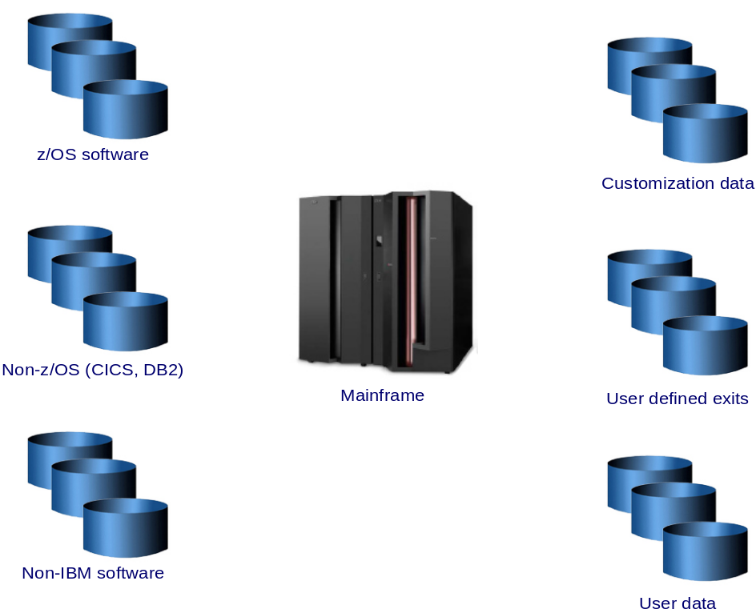
z/OS system libraries

Slide 19
Types of data
z/OS software on SYSRES volumes
Non-z/OS software e.g. CICS
Non-IBM software
Customization data – parmlib, IODF
User exits
User data – often the largest pool of volumes

Slide 20
z/OS system libraries
These are the most important system libraries
  SYS1.LINKLIB prime system software library
  SYS1.LPALIB system subroutines
  SYS1.NUCLEUS basic supervisor modules
  SYS1.PROCLIB system procedure JCL
  SYS1.PARMLIB control parameters

Slide 21
SYS1.LINKLIB
SYS1.LINKLIB is the main software library
LNKLST concatenation is a group of system and user-defined libraries which form part of the system search order for load modules
Not all on one volume

Slide 22
System search order for programs
Programs (load modules) must be in central storage and therefore in the virtual storage of the address space before they can run
System has a defined search order for a newly requested program

Slide 23
Search order for programs
STEPLIB if present
JOBLIB if present and no STEPLIB
Link Pack Area (LPA)
  Dynamic LPA modules
  Fixed LPA
  Modified LPA
  Pageable LPA
Linklist

Slide 24
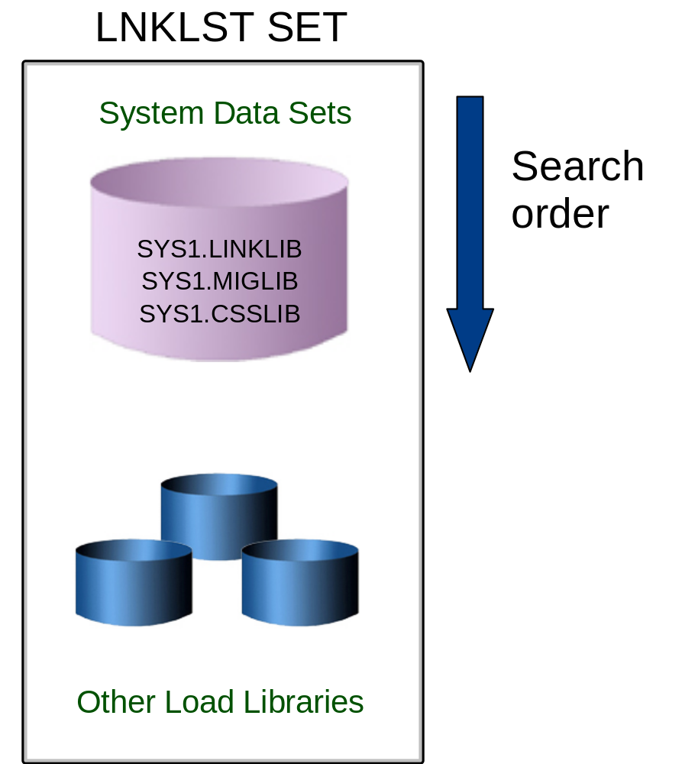
Overview of LNKLST – Fig 17.3

Slide 25
Using PROGxx to define LNKLST
A LNKLST set is an ordered list of datasets for processing as the LNKLST concatenation
The PROGxx member may be used to define other lists as well as the linklist
The linklist must be:
  Defined
  Have libraries added
  Activated

Slide 26
Example linklist definition:
LNKLST DEFINE NAME(LNKSYSA) COPYFROM(CURRENT)
LNKLST ADD NAME(LNKSYSA) DSNAME(SYS1.PROD.LOADLIB)
LNKLST ADD NAME(LNKSYSA) DSNAME(SYS1.TEST.LOADLIB)
LNKLST ACTIVATE NAME(LNKSYSA)
Notes:
This example shows added two new libraries to the linklist defaulting to a location of AT END. The current linklist is first copied. The two new libraries added then the new list activated. The new name must not be the same as an active linklist.

Slide 27
LLA and VLF
Library LookAside is an address space which maintains a copy of the directories of selected libraries to improve performance
By default, LLA always caches the linklist directories
Virtual Lookaside Facility is another address space which caches the most popular modules which reduces fetch time
VLF can also cache other data objects such as RACF tables to improve response
Notes:
By default LLA has the directories of linklist libraries. Others may be added as chosen by the installation. Good candidates may be popular ISPF libraries such as the panel library.

Slide 28
Libraries and members at IPL time
An number of libraries must be present for the system to load at IPL time
  SYS1.PARMLIB contains the required definitions
  SYSn.IPLPARM searched for LOADxx
  SYS1.LPALIB
  SYS1.PROCLIB
  SYS1.NUCLEUS

Slide 29
LOADxx
LOADPARM defines the address of the IODF and the suffix of the LOADxx member
At IPL the system searches for LOADxx in:
  SYS0.IPLPARM – SYS9.IPLPARM on IODF volume
  SYS1.PARMLIB on the IODF volume
  SYS1.PARMLIB on the IPL volume

Slide 30
LOADxx
The LOADxx member specifies:
  The IODF data set name
  The master catalog name and volume
  The parmlib concatenation
  The IEASYSxx member to use

Slide 31
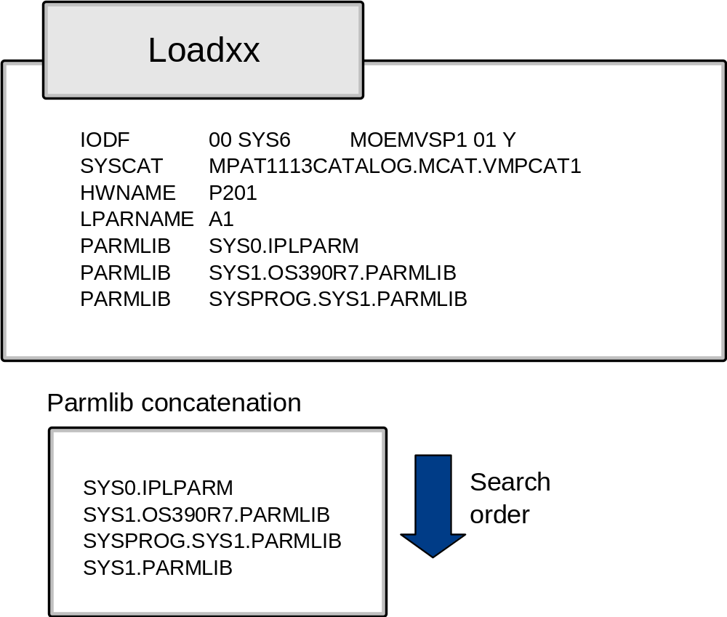
Fig 17.4 Defining a logical parmlib

Slide 32
IEASYSxx
This is the main parameter member for z/OS
IEASYS00 is used by default
If essential parameters are not specified then the operator will be prompted
Normally all parameters are specified to avoid inconsistent operator response

Slide 33
Parmlib commands
The parmlib concatenation can be displayed using D PARMLIB
The parameters used at IPL can be displayed using D IPLINFO
The parmlib concatenation can be modified dynamically using SETLOAD xx,PARMLIB

Slide 34
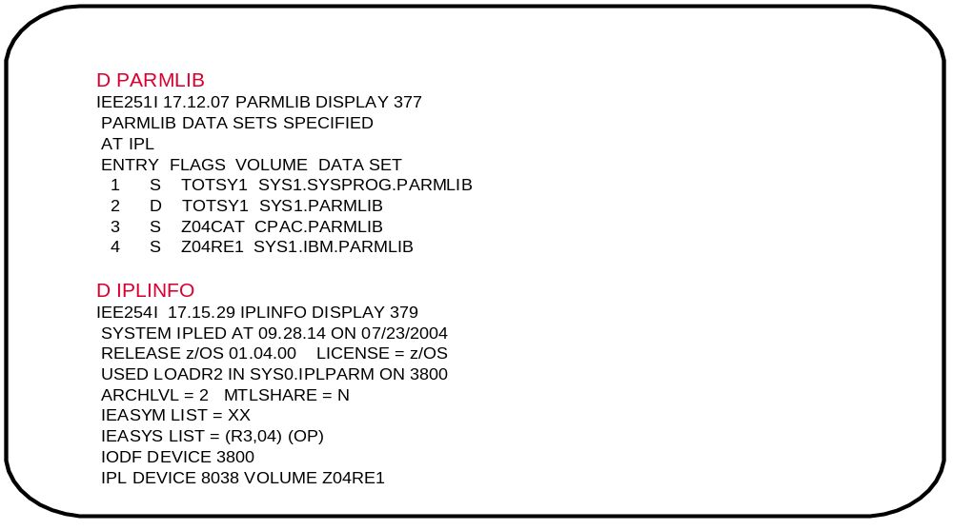
Fig 17.5 Commands to display parmlib

Slide 35
SYS1.LPALIB
The Link Pack Area (LPA) is built at IPL time from the modules defined in the LPALSTxx member of parmlib.
SYS1.LPALIB is always the first library used unless overridden by a SYSLIB statement
Modules are loaded into common storage at IPL time and so are available to all address spaces

Slide 36
SYS1.LPALIB
Fixed LPA comprises those modules defined in IEAFIXxx that are fixed in central storage
Pageable LPA comprises most other modules whose pages are eligible to be stolen
Modified LPA has modules which are temporary replacements for PLPA modules and is searched first.

Slide 37
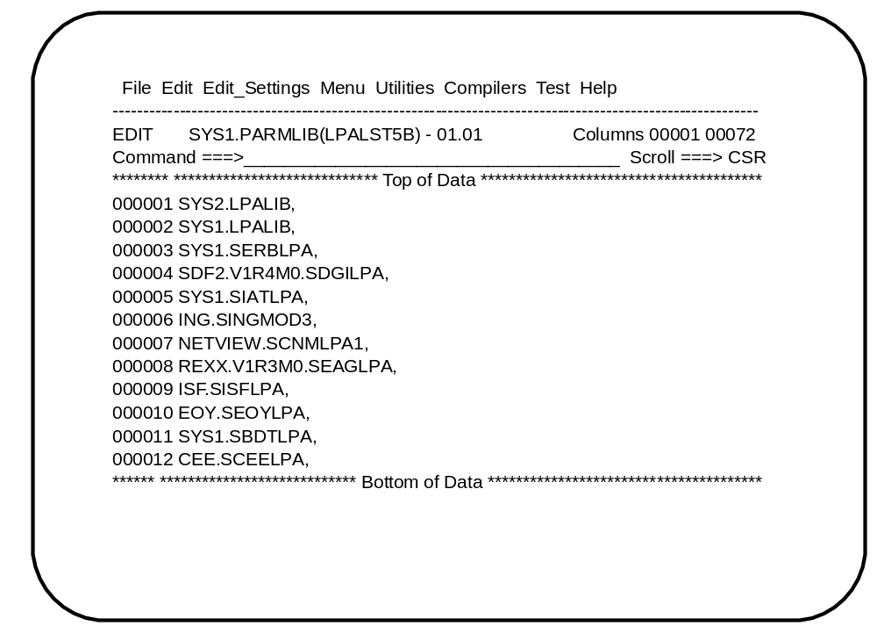
Example of LPALST member

Slide 38
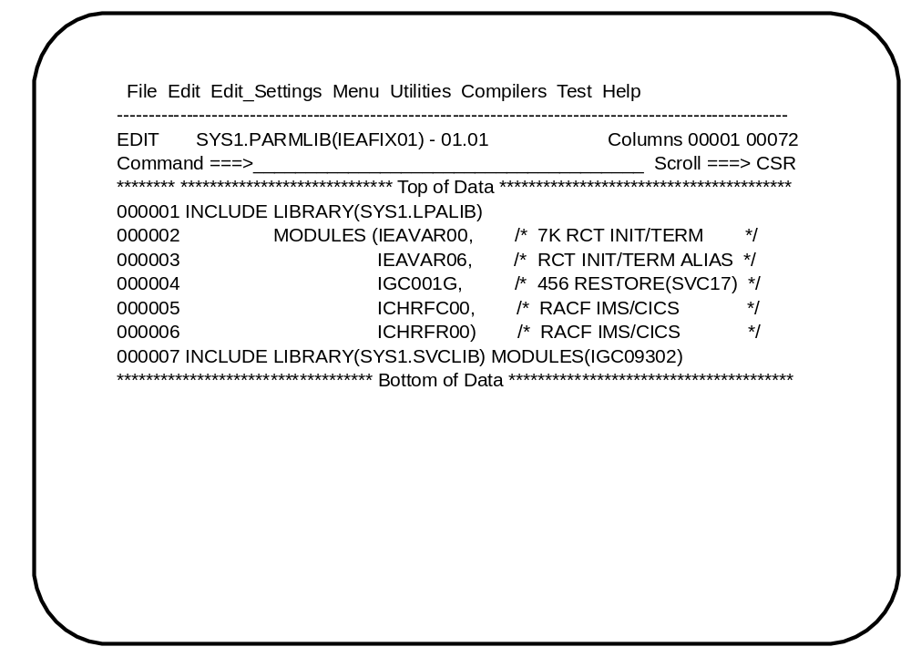
IEAFIX member

Slide 39
SYS1.PROCLIB
When the system is first IPL’d either the MSTJCL00 load module or MSTJCLxx in SYS1.PARMLIB is used to provide the JCL for the master scheduler
This JCL at a minimum points to SYS1.PROCLIB to provide the JCL procedures for the required tasks to run the system

Slide 40
Sample master JCL
//MSTJCL05 JOB MSGLEVEL=(1,1),TIME=1440
//EXEC PGM=IEEMB860
//STCINRDR DD SYSOUT=(A,INTRDR)
//TSOINRDR DD SYSOUT=(A,INTRDR)
//IEFPDSI DD DSN=SYS1.PROCLIB,DISP=SHR
//IEFPARM DD DSN=SYS1.PARMLIB,DISP=SHR
//SYSUADS DD DSN=SYS1.UADS,DISP=SHR
//SYSLBC DD DSN=SYS1.BRODCAST,DISP=SHR

Slide 41
A job’s procedure library
The JES cataloged procedure in SYS1.PARMLIB contains lists of procedure libraries to be searched for JCL procedures
JCLLIB may also be used to specify a private library to be searched first

Slide 42
Procedure library
//PROC00 DD DSN=SYS1.PROCLIB,DISP=SHR
// DD DSN=SYS3.PROD.PROCLIB,DISP=SHR
//PROC01 DD DSN=SYS1.PROC2,DISP=SHR
...
//PROCnn DD DSN=SYS1.LASTPROC,DISP=SHR
...
//MYJOB JOB
//MYLIBS JCLLIB ORDER=(MY.PROCLIB.JCL,SECOND.PROCLIB.JCL)
//S1 EXEC PROC=MYPROC1
...

Slide 43
System symbols
System symbols allow the use of a shared parmlib by two or more systems
Each symbol has a name which can be used in various places and then substituted at IPL time
Major uses are indirect cataloging and substituting system specific datasets such as the page data sets

Slide 44
System symbols
SYSDEF HWNAME(SCZP801)
LPARNAME(A08)
SYSNAME(SC04)
SYSPARM(R3,04)
SYMDEF(&CPCNAME='P801')
SYMDEF(&DFHSMHST='ON')
SYMDEF(&SYSR2=’ZXYSY2’)
SYMDEF(&SYSR3=’&SYSR1(1:5).3’)

Slide 45
Use of system symbols
PAGE=(PAGE.&SYSNAME..&PLPADSN1.,
PAGE.&SYSNAME..&COMMDSN1.,
PAGE.&SYSNAME..LOCAL1,
PAGE.&SYSNAME..LOCAL2,L)

Slide 46
Summary
The role of the system programmer is to install customize and maintain the operating system and must be aware of:
  z/OS operational system administration
  Workload management
  System performance
  Job flow
  I/O device management
  Security/integrity/availability
  z/OS Operation
  Change management

